Slide 1

Joumana Obeid
Customer Churn
Using ML and DA
19th June - 2024

Slide 2

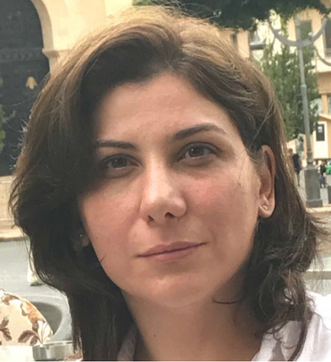
Scope and Background
Project Scope: Develop a machine-learning model to predict customer churn.
Background: Understanding churn helps in retaining customers and improving service quality.
Objective: Leverage data analysis and predictive modeling to identify key factors influencing churn.
Joumana Obeid
Github:
https://github.com/jumobeid/DataScience
Linked In :
https://www.linkedin.com/in/joumana-obeid-586532297/

Slide 3


Project Participation
About my teams
Team Player: Managed team of 4-5 and 6 students .
My role was the Team Leader in more than overall 35 projects in the last three years
Tools used
Tools Used: Python, R, Jupyter Notebook, Seaborn, Matplotlib
Data Source
https://github.com/IBM/telco-customer-churn-on-icp4d/tree/master/data:

Slide 4

Project Overview
Goal: Predict customer churn and understand contributing factors.
Methods: Data cleaning, exploratory data analysis (EDA), data visualization, and predictive modeling.
Approach: Comprehensive analysis using Python and R for a detailed understanding.

Slide 5



Data Set and Data Cleaning
Data Source
Dataset: IBM Telco Customer Churn Dataset
Sample Size: 7043 customers
Features: 21 input features, 1 target variable (Churn)
Data Fields
Data Cleaning
Customer Information: CustomerID, Gender, SeniorCitizen, Partner, Dependents
Services: PhoneService, MultipleLines, InternetService, OnlineSecurity, etc.
Financial Information: MonthlyCharges, TotalCharges
Target Variable: Churn
Conversion: 'TotalCharges' to float type
Handling Missing Values: Replaced zero values with the mean
Duplicates: Removed 22 duplicate records, resulting in 7021 unique records.
Removed customer id.

Slide 6
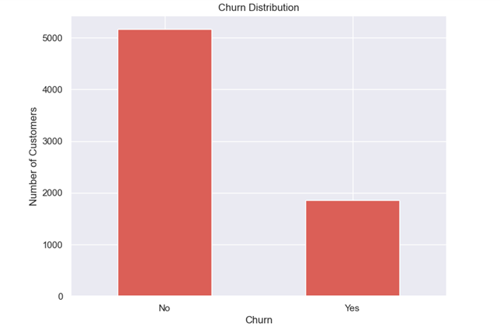
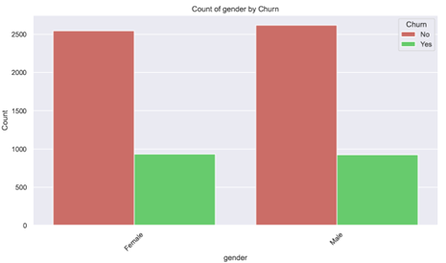
Exploratory Data Analysis
Churn Distribution: Analysis of churn rates across different features
Key Insights:
No churn perrcentage is 73.5% , churn percentage is 26..4%
Equal churn rates by gender

Slide 7
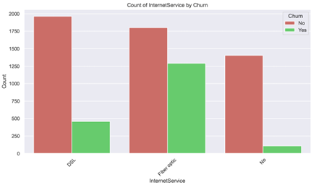
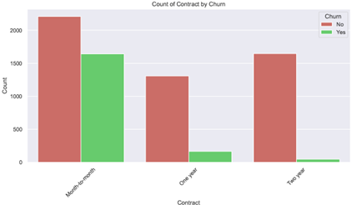
Exploratory Data Analysis
Key Insights:
Higher churn for Fiber optic users
Customers with month to month contract are more likely to churn

Slide 8
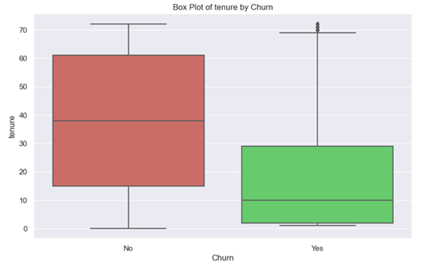
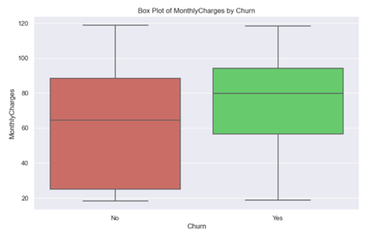
Exploratory Data Analysis
Key Insights:
Higher churn for customers with higher monthly charges.
Cutomer with longer tenure are more likely to be loyal to the company.

Slide 9
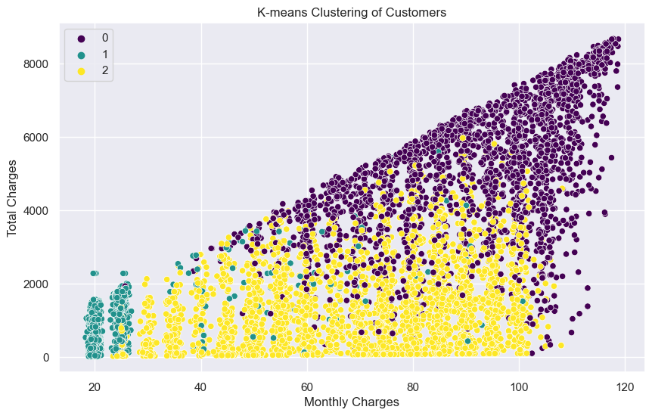
Customer Segmentation
Using K-means clustering which is unsupervised machine algorithms to separate the customer’s according to their monthly charges.
Value for Retention Strategies: ,Service Optimization:

Slide 10



Significance of tenure, monthly charges, total and charges
Tenure
Monthly charges
Total Charges
2.Monthly Charges: For each additional unit increase in monthly charges, the odds of churn increase by approximately 3.13% (coefficient = 0.03125). This suggests that higher monthly charges are associated with a greater likelihood of customer churn.
1.Tenure: For each additional unit increase in tenure, the odds of churn decrease by approximately 6.22% (coefficient = -0.06219). This means that longer-tenured customers are less likely to churn.
Although there appears to be a relationship between total charges and churn, this relationship is not necessarily significant.

Slide 11

Machine Learning Model
01
02
Logistic Regression Model
Random Forest Model
Performance Metrics: Accuracy, precision, recall, F1-score, AUC
Results:
Accuracy: 79.2%
AUC: 0.85
Interpretation: High AUC indicates a well-performing model
Random Forest Analysis
Performance Metrics: Accuracy, precision, recall, F1-score, AUC
Results:
Accuracy: 78.9%
• Comparison: Similar performance to logistic regression

Slide 12
Key Insights
Model Insights
Key Findings:
Both models show high accuracy
Logistic regression has higher precision and recall for non-churn
Random forest performs better in predicting churn
Actionable Insights:
Focus on identifying churn cases
Target retention efforts

Slide 13
Conclusion
Conclusion:
High AUC (0.85) confirms model suitability
Segmentation provides actionable insights for retention and service optimization
Lessons Learned:
Importance of data cleaning and EDA
Value of segmentation in understanding customer behavior
Need for continuous model refinement and targeted strategies

Slide 14




Contact Us
Get in touch with us:
Contact to our email
jumana-o@live.com
Visit our website
https://jumobeid.wixsite.com/my-site

Slide 15



Customer Churn 2024
Thank You
For Your Attention
Visit Our Website
https://www.connexall.com/

